Slide 1
CIS8695 Managing Big Data Analytics
Nasim Mousavi
Assistant Professor
J. Mack Robinson College of Business
Georgia State University
nmousavi@gsu.edu

Slide 2
Recommendation Systems

Slide 3
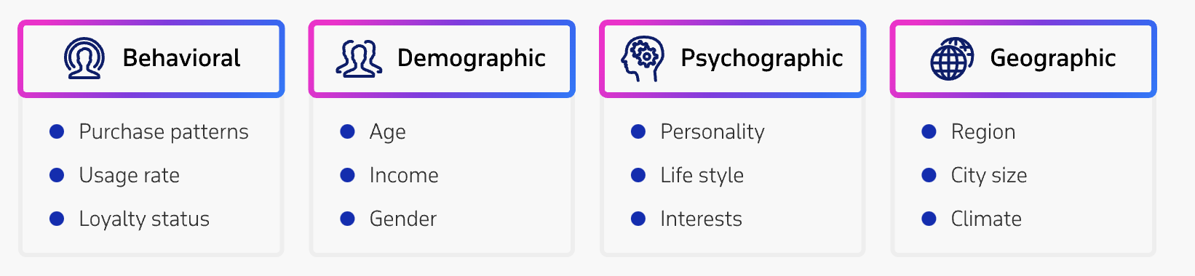
What is Recommendation System (RS)?
An engine based on machine learning algorithms to segment customers based on their interest, and behavioral patterns
Suggests them product and content that would be interesting for them

Slide 4
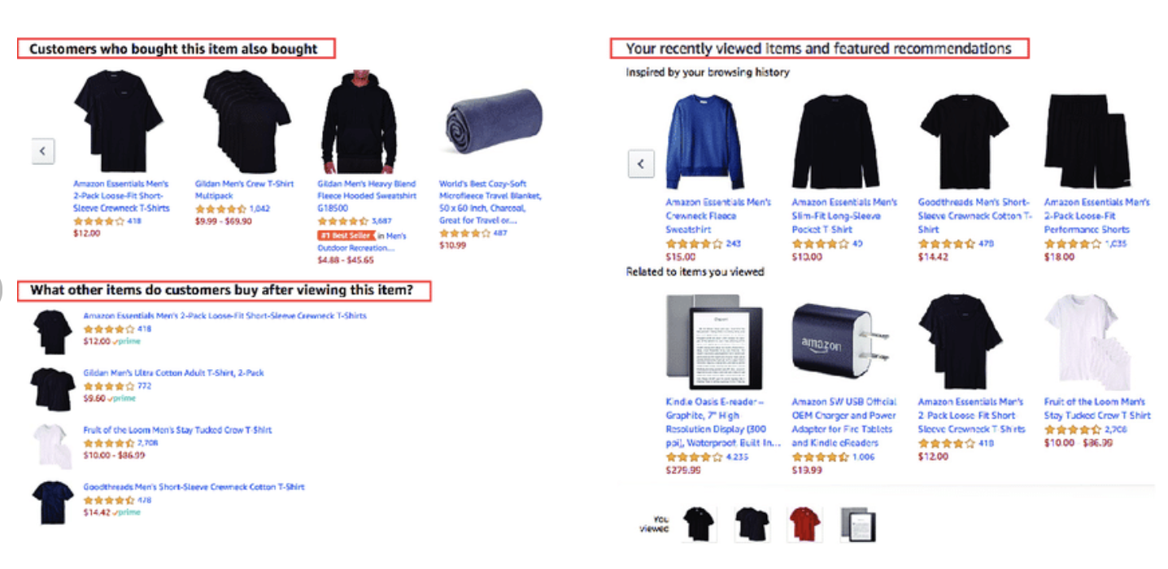
Application

Slide 5
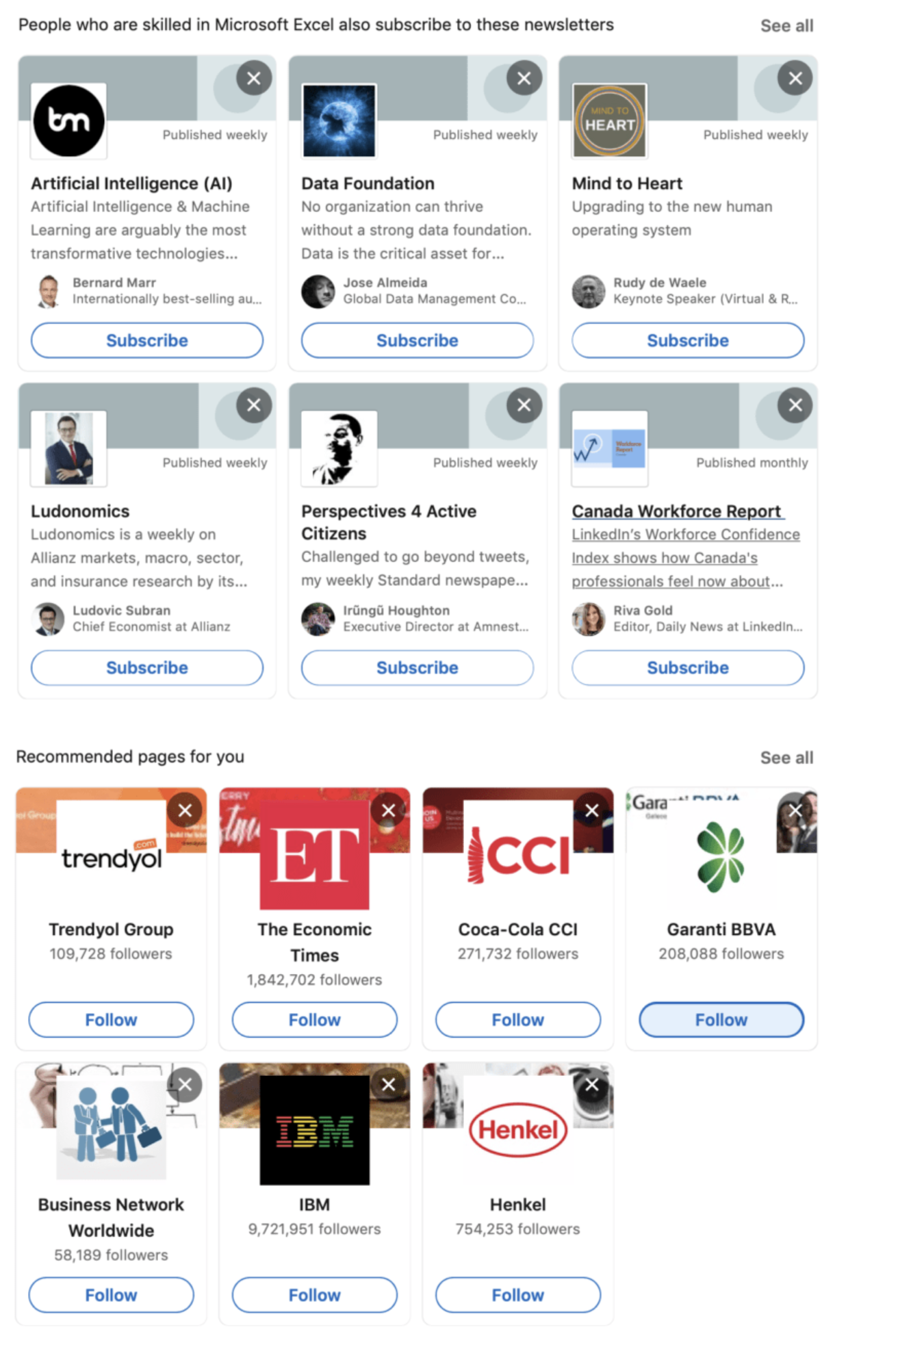
Application

Slide 6
Why RS?
RS helps users in their information gathering and decision-making journey
By providing content that customers would be most likely interested in
Facilitating their decision-making
By providing long tail (niche) items that customers would not be able to find them by themselves
RS is highly profitable for companies
Could consider customers and companies’ interests at the same time
Would result in satisfied customers
Satisfaction would result in royalty

Slide 7

Example of RS Application

Slide 8
Different Types of Recommendations
General recommendations
Based on association rules
Popular items
New items
…
Personalized recommendations
Collaborative filtering
User based
Item based
Content filtering
Hybrid

Slide 9
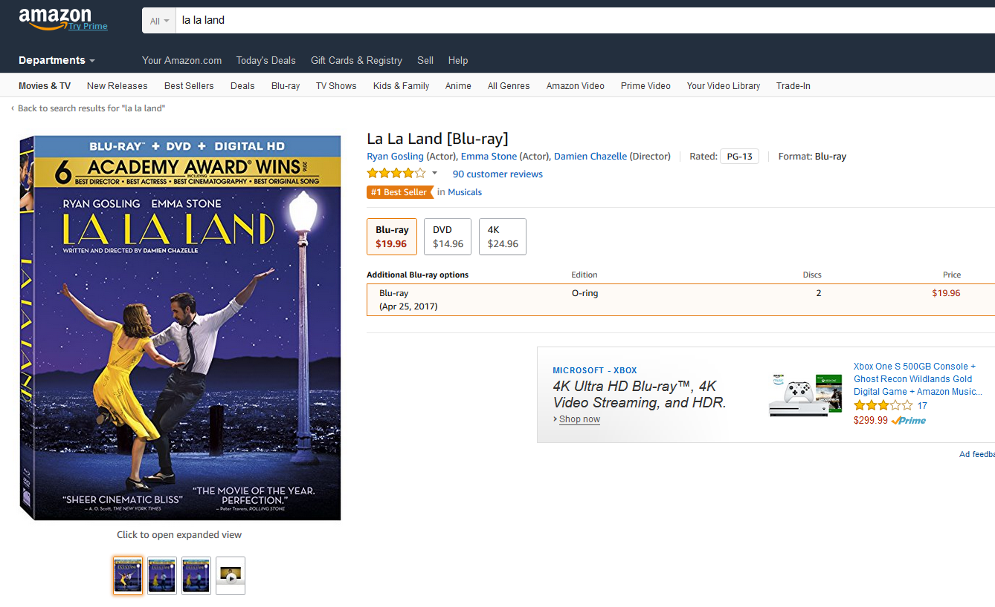
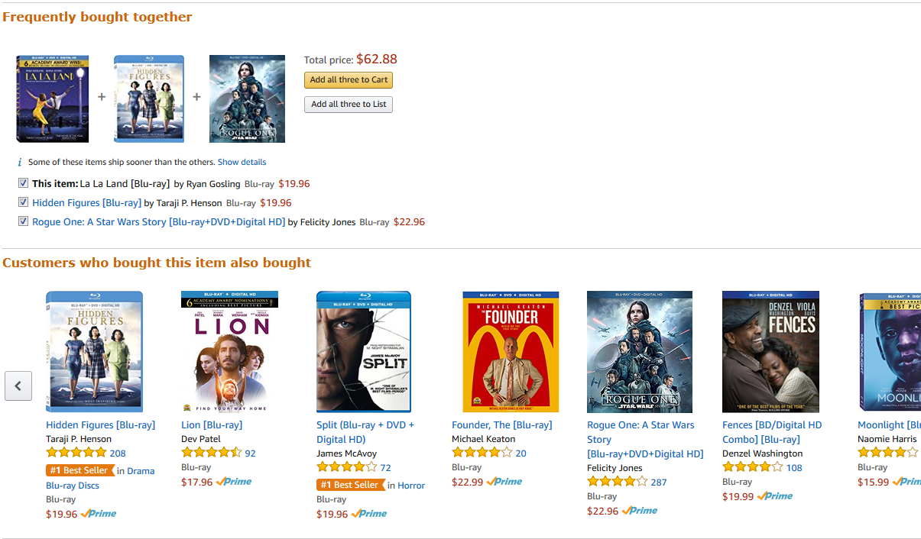
Association Rule for Recommendation

Slide 10
Association Rules

Slide 11
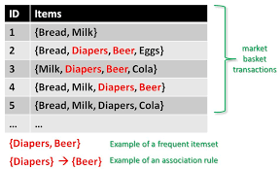
What is Association Rule?
Study of “what goes with what”
Customers who bought X also bought Y
Transaction-based or event-based analysis
Also called “market basket analysis” and “affinity analysis”

Slide 12
Applications (1)
Items = products; baskets = sets of products someone bought in one trip to the store
Example application: given that many people buy beer and diapers together:
Run a sale on diapers; raise price of beer
Only useful if many buy diapers & beer

Slide 13
Applications (2)
Baskets = Web pages; items = words
Example application: Unusual words appearing together in a large number of documents, e.g., “Brad” and “Angelina,” may indicate an interesting relationship

Slide 14
Applications (3)
Baskets = sentences; items = documents containing those sentences
Example application: Items that appear together too often could represent plagiarism

Slide 15
Association Rule
The goal is finding frequent item sets
Given a set of transactions, find combinations of items (item sets) that occur frequently
Items: {Bread, Milk, Diaper, Beer, Eggs, Coke}
Examples of frequent item sets with occurrence more than 3
{Bread}: 4
{Milk} : 4
{Diaper} : 4
{Beer}: 3
{Diaper, Beer} : 3 {Milk, Bread} : 3

Slide 16
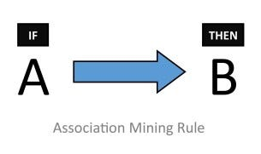
Association Rule: If-Then Condition
“IF” part = antecedent
“THEN” part = consequent
Example: IF a customer buy beer, THEN he buys diapers

Slide 17
Association Rule: If-Then Condition
“Item set” = the items (e.g., products) comprising the antecedent or consequent
Item set = {A,B}
Antecedent and consequent are disjoint (i.e., have no items in common)

Slide 18
Example: Phone Case
Transaction | Case Colors Purchased
1 | red | white | green
2 | white | orange
3 | white | blue
4 | red | white | orange
5 | red | blue
6 | white | blue
7 | white | orange
8 | red | white | blue | green
9 | red | white | blue
10 | yellow

Slide 19
Many Rules are Possible
E.g., Transaction 1 supports several rules, such as
“If red, then white”
“If red and white, then green”
……
Transaction | Case Colors Purchased
1 | red | white | green

Slide 20
Frequent Item Sets
Ideally, we want to create all possible combinations of items
Problem: computation time grows exponentially as # items increases
Solution: consider only “frequent item sets”
Criterion for frequent: support

Slide 21
Support
Support for an item set
#(%) of transactions that include an item set
Example: support for the item set {red, white} is 4 out of 10 transactions, or 40%
Transaction | Case Colors Purchased
1 | red | white | green
2 | White | orange
3 | white | blue
4 | red | white | orange
5 | red | Blue
6 | white | Blue
7 | white | Orange
8 | red | white | blue | Green
9 | red | white | Blue
10 | yellow

Slide 22
Generating Frequent Item Sets
For k products…
User sets a minimum support criterion (minsupp)
Next, generate list of one-item sets that meet the support criterion
Use the list of one-item sets to generate list of two-item sets that meet the support criterion
Use list of two-item sets to generate list of three-item sets
5.Continue up through k-item sets

Slide 23
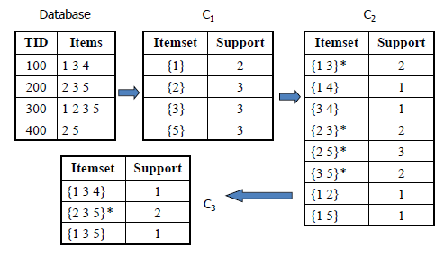
Generating Frequent Item Sets

Slide 24
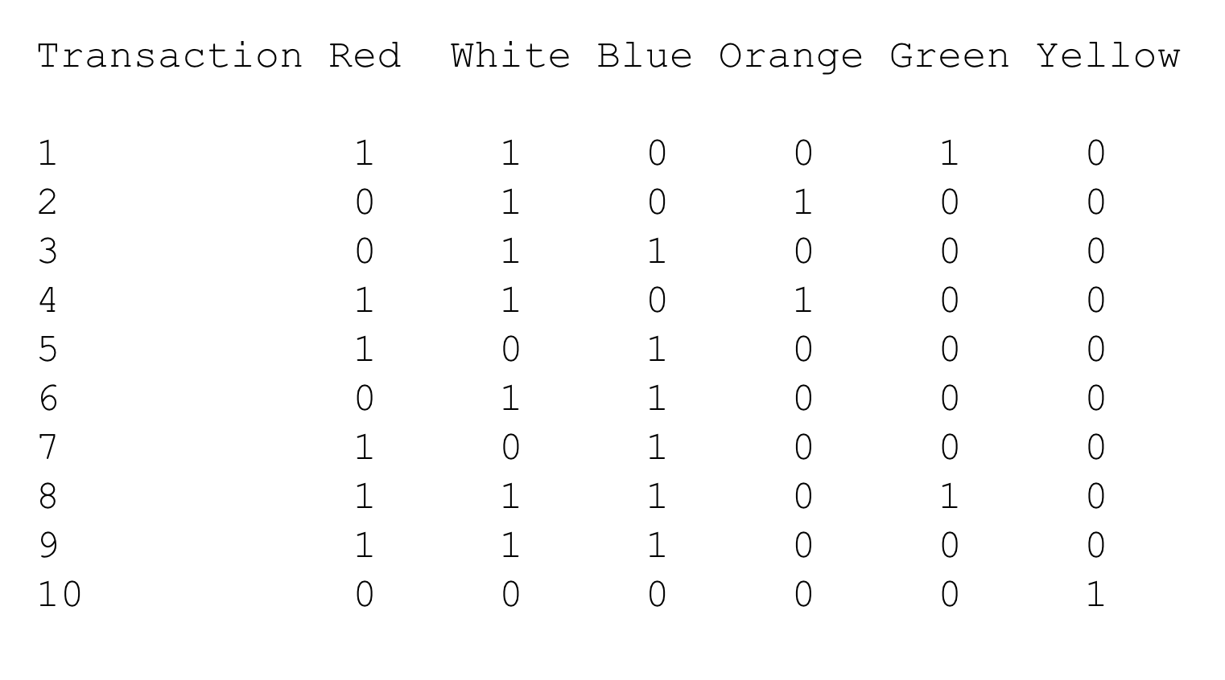
Example: Binary Matrix of Phone Case

Slide 25
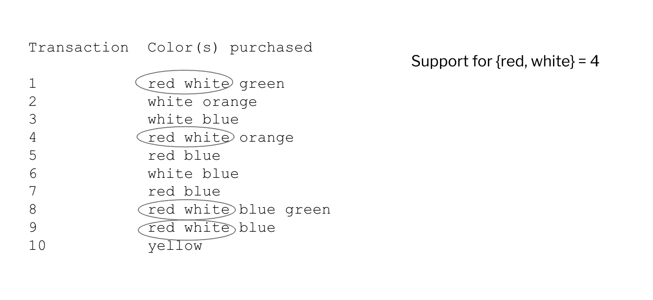
Support

Slide 26
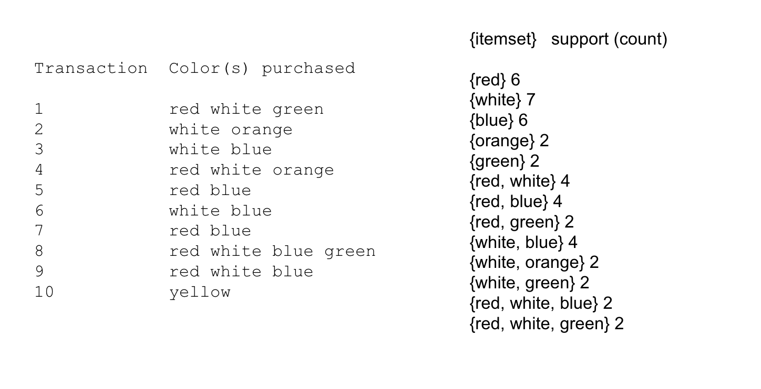
Support For Various Item Sets

Slide 27
Convert Frequent Item Sets to Rules
We then can convert frequent item sets to rules
But how should we assess the rules?

Slide 28
Assess Rules
Confidence
% of antecedent transactions that also have the consequent item set
Likelihood that consequent will be found in transactions with antecedent
Lift Ratio
Shows how efficient the rule is in finding consequents compared to random selection (i.e. more useful than just selecting transactions randomly)
Confidence/(Benchmark Confidence)

Slide 29
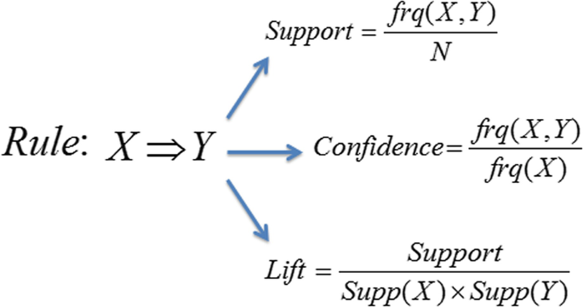
Measurements Summary

Slide 30
Process of Rule Selection
Generate all rules that meet specified support & confidence
Find frequent item sets (those with sufficient support)
From these item sets, generate rules with sufficient confidence
Assess rule performance using lift ratio

Slide 31
Example: Binary Matrix of Phone Case

Slide 32
Example: Rules from {red, white, green}
{red, white} > {green} with confidence = 2/4 = 50%
{red, green} > {white} with confidence = 2/2 = 100%
If confidence criterion is 70%, report only rules 2

Slide 33
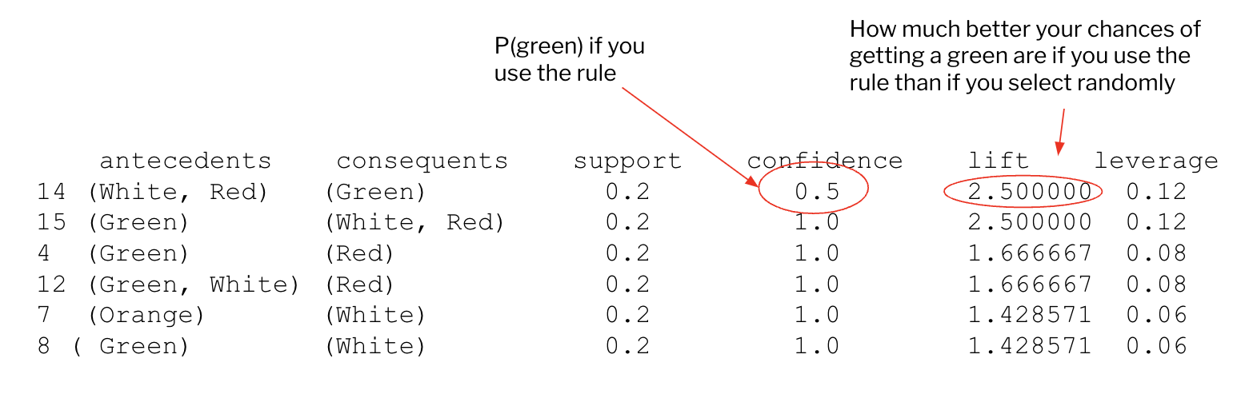
Python Result

Slide 34
Interpretation
Lift ratio and leverage show how effective the rule is in finding consequents (useful if finding particular consequents is important)
Confidence shows the rate at which consequents will be found (useful in learning costs of promotion)
Support measures overall impact

Slide 35
Summary – Association Rules
Association rules produce rules on associations between items from a database of transactions
Consider only “frequent” item sets (=support) to reduce computation complexity
Measure performance of rules using confidence and lift

Slide 36
Collaborative Filtering

Slide 37
Collaborative Filtering
Is a popular technique used by recommendation systems
Identify relevant items for a specific user from the very large set of items (“filtering”)
Consider preferences of many users (“collaborative)

Slide 38
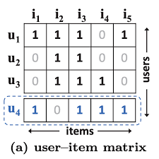
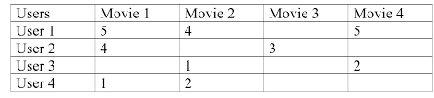
Collaborative Filtering

Slide 39
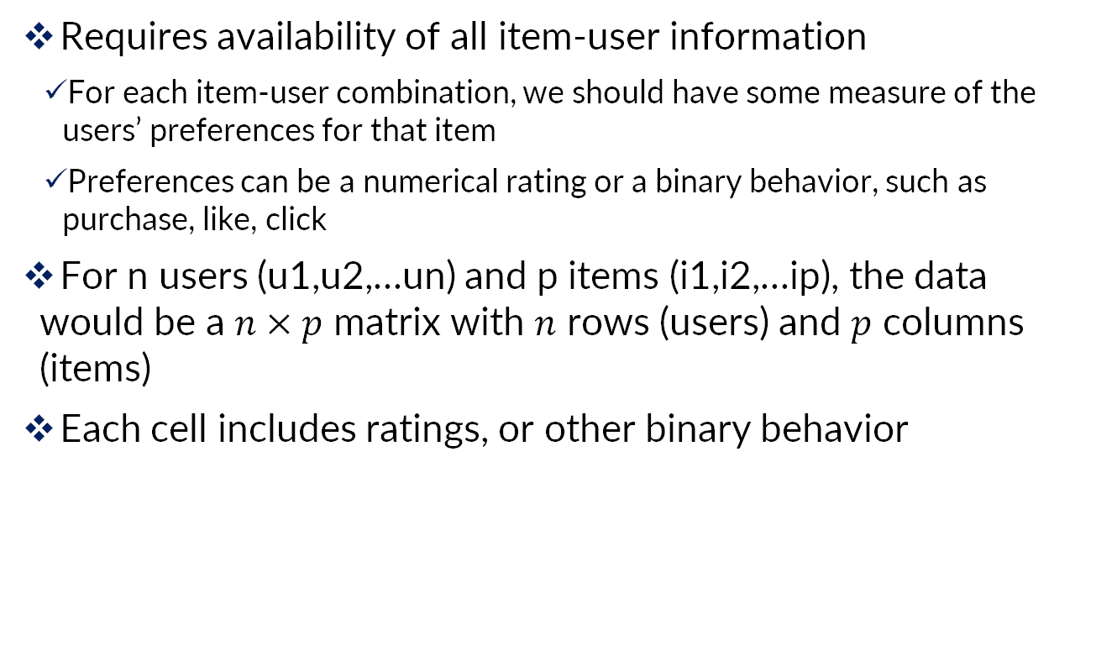
Collaborative Filtering
Requires availability of all item-user information
For each item-user combination, we should have some measure of the users’ preferences for that item
Preferences can be a numerical rating or a binary behavior, such as purchase, like, click
For n users (u1,u2,…un) and p items (i1,i2,…ip), the data would be a $n×p$ matrix with $n$ rows (users) and $p$ columns (items)
Each cell includes ratings, or other binary behavior

Slide 40
Collaborative Filtering : UBCF
User-based (UBCF)
Finding users with similar preferences with the focal user, and recommend items that they liked but the users has not purchased

Slide 41
Collaborative Filtering: UBCF
Imagine that you want to recommend a movie to your friend John
We could assume that similar people will have similar taste
Suppose that you and John have seen the same movies, and rated them all almost identically
But John hasn’t seen ‘The Godfather: Part II’ and you did
If you love that movie, it sounds logical to think that he will too
With that, we have created an artificial rating based on our similarity

Slide 42
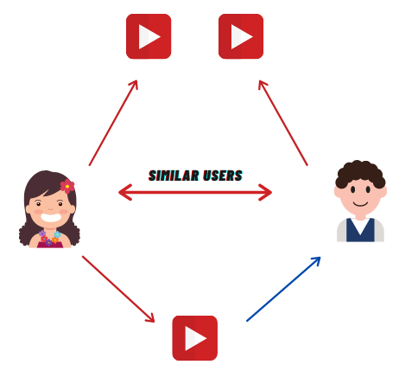
Collaborative Filtering: UBCF
Liked by You & John

Slide 43
Collaborative Filtering: UBCF
Two steps should be followed:
1. For a user, find other users who share his/her preferences
Needs a distance metric to measure the similarity between users
Pearson correlation, cosine similarity
Use a threshold on the distance or on the number of neighbors to determine the nearest neighbors
2. Recommend the highest-rated item that the user has not consumed

Slide 44
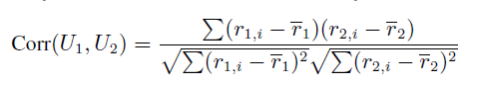
User-Based CF: Pearson Correlation
Find the closest neighbors to each user
Like the k-nearest neighbor
But Euclidean distance does not do well
Unsuitable for high-dimensional data due to curse of dimensionality
Correlation proximity does better (Pearson)
For each user pair, find the co-rated items, calculate correlation between the vectors of their ratings for those items
Note that the average ratings for each user are across all products, not just the co-rated ones

Slide 45
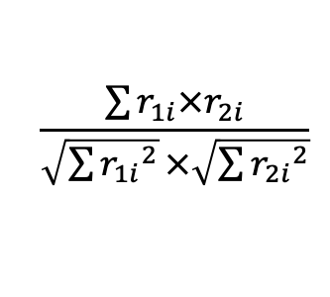
User-Based CF: Cosine Similarity
Like correlation coefficient, except do not subtract the means
$$\frac{\sum{r_{1i}×r_{2i}}}{\sqrt{\sum{{r_{1i}}^{2}}}×\sqrt{\sum{{r_{2i}}^{2}}}}$$

Slide 46
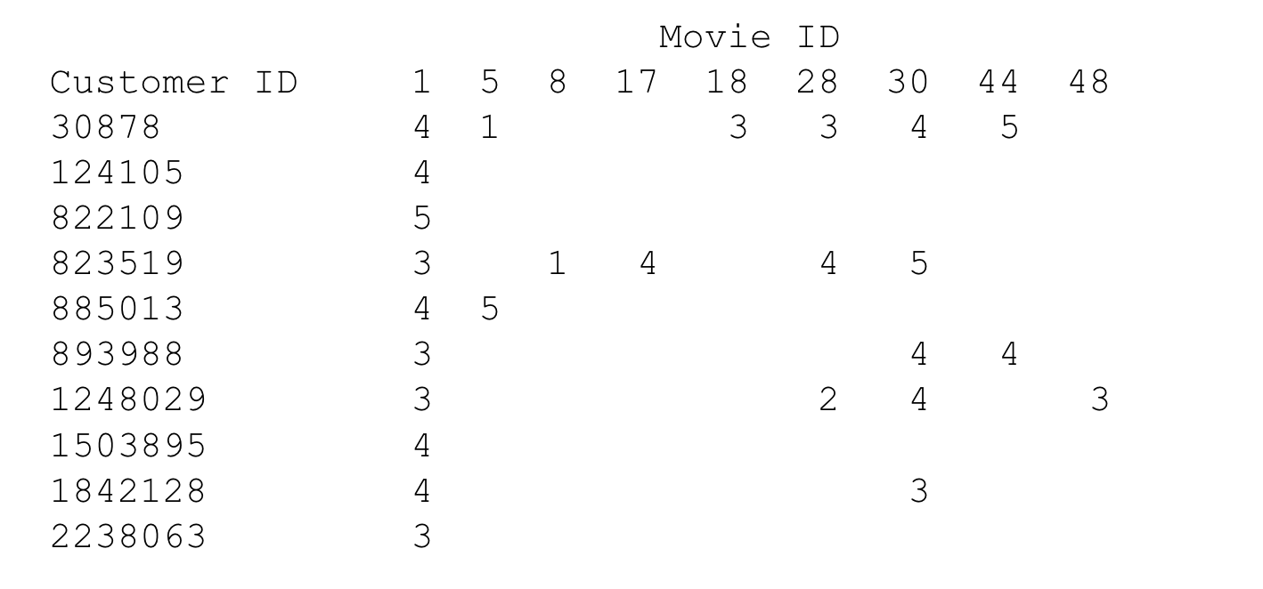
Netflix Example
Consider users 30878 and 823519

Slide 47
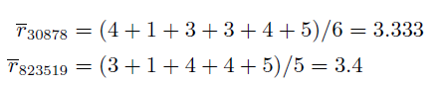
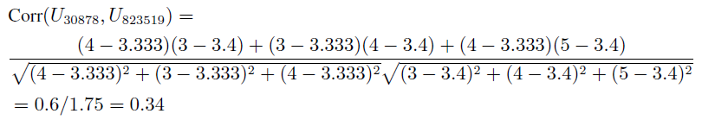
User-Based CF: Pearson Similarity
First find average ratings for each user:
Find correlation using departure from avg. ratings for the co-rated movies (movies 1, 28 and 30):

Slide 48
Collaborative Filtering: IBCF
User-based (UBCF)
For a user, find other users who share his/her preferences
Recommend the highest-rated item that the user does not have.
User-user correlations cannot be calculated in advance
Slow
Item-based (IBCF)
For a user considering an item, find another item that is most similar to the item

Slide 49
Collaborative Filtering: IBCF
When the number of users is much larger than the number of items, it is computationally cheaper and faster to find similar items than similar users
Two steps:
Find the items that were co-rated, or co-purchased (by any user) with the item of interest
Recommend the most similar (correlated item(s)) items

Slide 50
Collaborative Filtering: IBCF
Back to the John example
Instead of focusing on his friend (you), we focus on the similarity between items calculated using the rating other users have given to items
This new focus is known as Item-Based Collaborative Filtering (IB-CF)

Slide 51
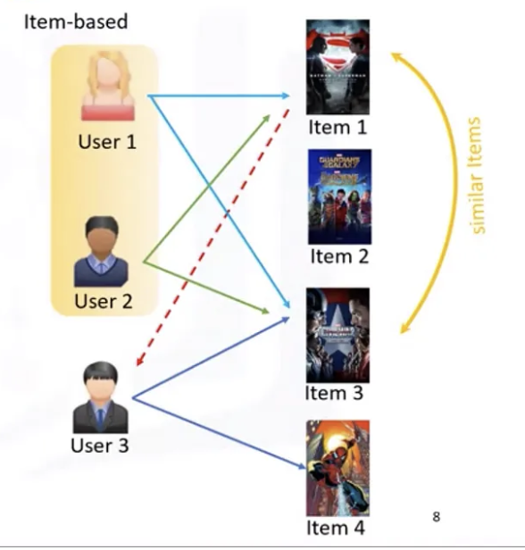
Collaborative Filtering: IBCF

Slide 52
Netflix Example
Consider movie1 and movie 5

Slide 53

Netflix Example
Average rating for movie 1 =3.7
Average rating for movie 5 =3

Slide 54
Association Rules vs. Collaborative Filtering
Association rules: focus entirely on frequent (popular) item combinations. Data rows are single transactions. Ignores user dimension. Often used in displays (what goes with what).
Collaborative filtering: focus is on user preferences. Data rows are user purchases or ratings over time. Can capture “long tail” of user preferences – useful for recommendations involving unusual items

Slide 55
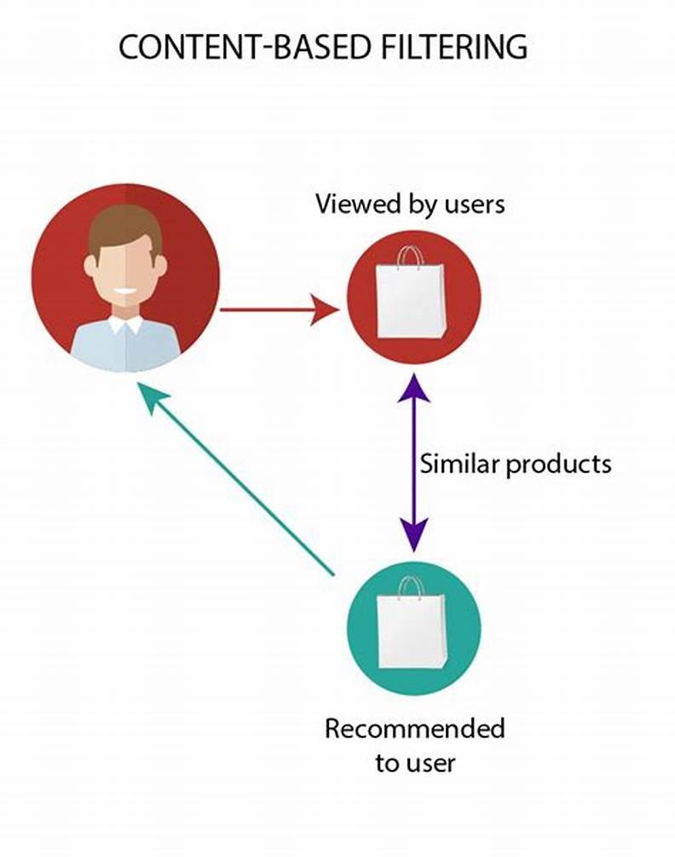
Content Based Recommendations
Works with data that the user provides
Either explicitly (rating) or implicitly (clicking on a link)
Based on that data, a user profile is generated, which is then used to make suggestions to the user

Slide 56
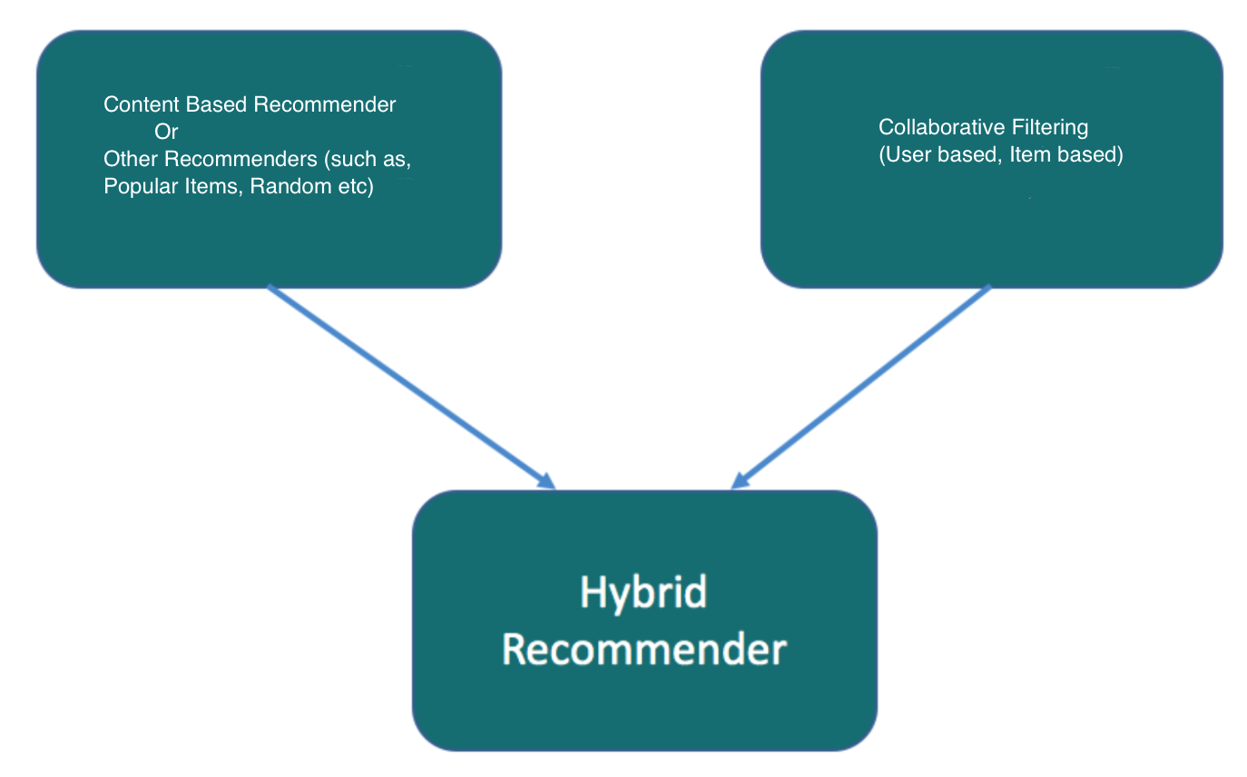
Hybrid Recommender

Slide 57

Case Study: Netflix

